Slide 1
Groupware system

Slide 2
Group 5
Laurence Cabenda
Bogdan Dumitriu
Richard Nieuwenhuis
Huanwen Qu

Slide 3
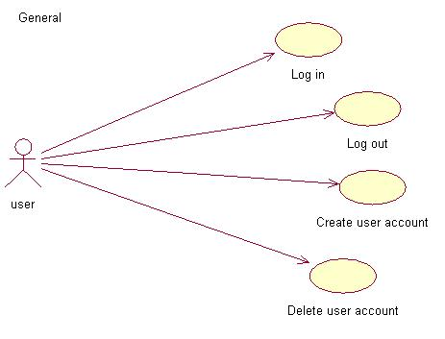
Use cases (general)

Slide 4
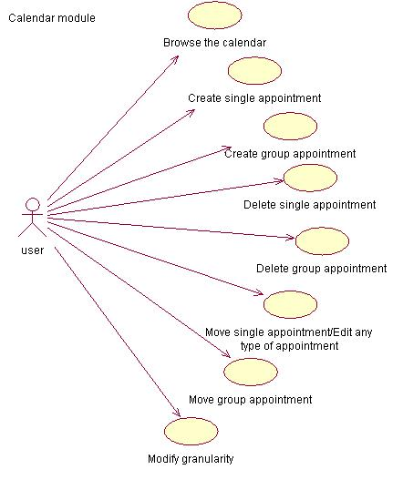
Use cases (calendar)

Slide 5
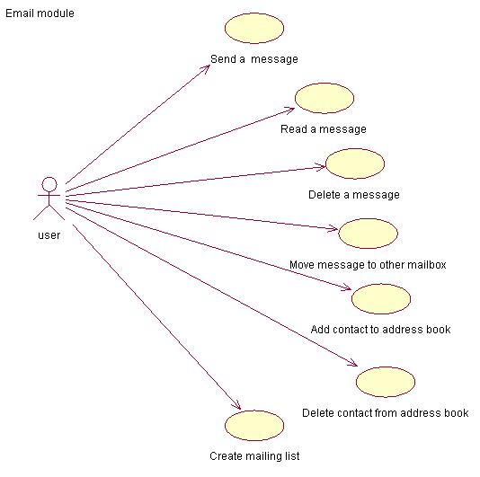
Use cases (email)

Slide 6
MailingList
Remote
MailBox
UserData
MailBoxImpl
GroupWareManagement
User
AddressBook
MailAccount
Contact
GroupWareManagementImpl
UserImpl
AddressBookImpl
MailAccountImpl
Message
UnicastRemoteObject

Slide 7
PostgreSQL Database
UserFinder
DbConnection
Finder
MessageFinder
MailAccountFinder
AddressBookFinder
MailBoxFinder

Slide 8
Remote
UserData
ClientObserver
GroupManagement
User
Group
Calendar
ClientObserverImpl
GroupManagementImpl
UserImpl
GroupImpl
CalendarImpl
Appointment
Period
UnicastRemoteObject

Slide 9
PostgreSQL Database
DbConnection
Finder
AppointmentFinder
CalendarFinder
UserFinder

